Slide 1




Hint
differences ? its in the picture
hutao girl.
is best

Slide 2






AICS
Maximilian See
Type your Admin Number
Ensemble Modelling of Hybrid CNN, Autoencoders, and DCT with AAEs for Steganalysis
#2102869A
Intro

Slide 3
What
Steganalysis is a crucial technique used to identify concealed information within digital media, and its significance spans across various fields such as cybersecurity, digital forensics, and intelligence gathering. As a counterpart to steganography, which aims to hide secret data, steganalysis focuses on revealing covert communication. By employing steganalysis, professionals can uncover hidden messages and ensure the integrity of digital information, thus playing a vital role in maintaining data security and authenticity.

Slide 4

Why
Stenograph image
Non stego image
Hidden beneath the seemingly ordinary appearance of an image lies the potential for malicious content. It is imperative for Network Monitoring Systems to possess the ability to identify such hidden characteristics. Failing to detect these concealed elements can lead to catastrophic consequences for the entire network system. The ramifications of leaving such threats undetected are far-reaching, underscoring the critical importance of robust monitoring and detection mechanisms.
NMS:
LMAO GOT EM
Posted by #weebhacker

Slide 5
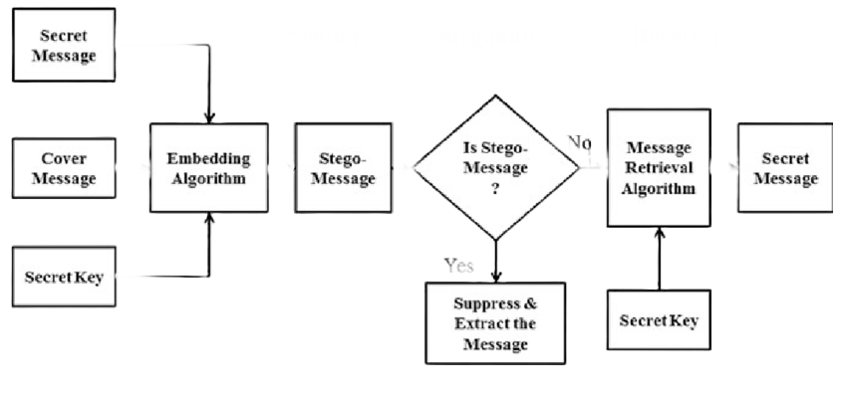
How are they made ?
DCT
Secret Message hidden in Frequency Domain

Slide 6



Email Gateways
Model held at email Gateways
Where are they Held ?
They will be assumed to be held at these locations in a
company
Network Internal Monitoring Systems
Model held at NIMS
Network Perimeter Monitoring System
Model held at NPMS

Slide 7
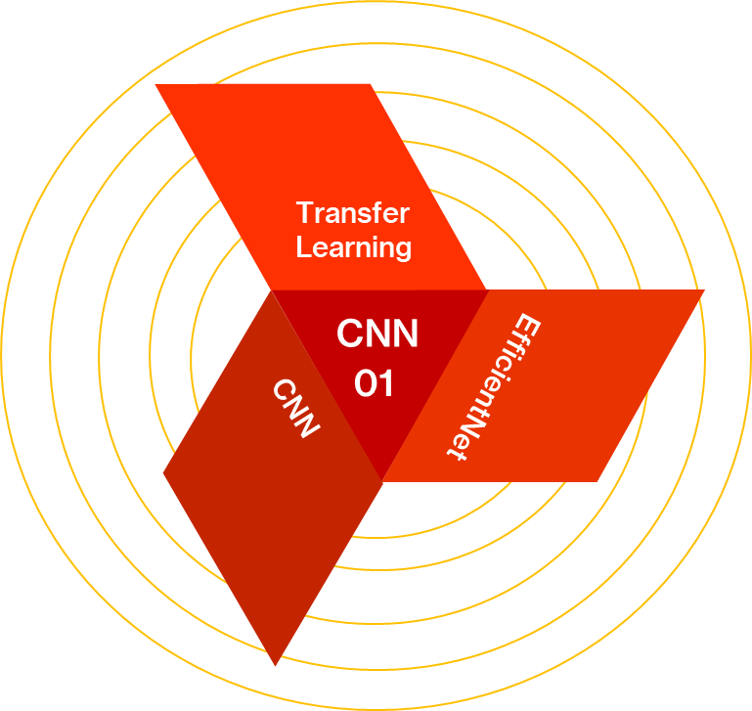
Model Type
Parameters
CNN
8,354,675
Max Val Accuracy
Model Type
58%
Supervised

Slide 8
Model Architecture
Parameters
Hybrid
18,072,936
DCT Features
Aims to provide another perspective by looking at the frequency domain.
Auto Encoders
Serve as feature extractors & dimension reduction for DCT Features
DCT
CAESR
04
AEs
CNN & MLP
CNN Serve as feature extractors. While MLP serve as the FCL/Decision Layer
CNNSR + MLP
Max Theoretical Val Accuracy
Model Type
72-92%
Supervised

Slide 9
Model Type
Parameters
Hybrid
69,397,128
Discriminator
Distinguish between the latent representations
Spatial Domain
Changing the colour space to garner more information.
GANs
AAE
02
Auto Encoders
YcCbBr
AEs
Learn a compact representation of the input data and then reconstruct
Max Val Accuracy
Model Type
80%
Unsupervised

Slide 10
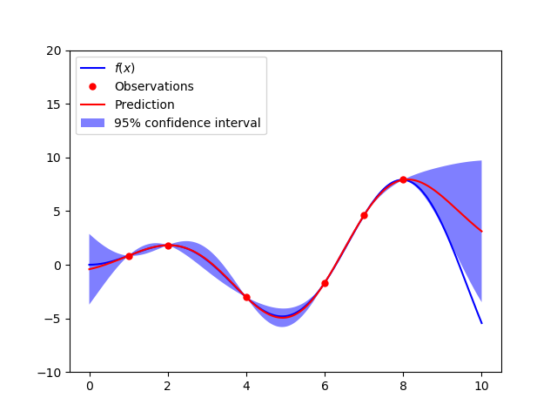
Tuning Methodology
Bayesian Optimization
Bayesian
Bayesian optimization is a method for finding the best set of parameters for a machine learning model. It works by creating a probability model of how the model's performance is affected by changes in its parameters

Slide 11

HCNN & AAEs
Model Weakness
Robustness
Generalization
Within the framework of our model, it exhibits limitations in detecting steganographic images with minor augmentations. Even small augmentations, such as shifting images by one pixel or altering their resolution, have a notable impact on the accuracy and precision of the model.
Our current training dataset primarily consists of images steganographed with algorithms such as JUNIward, JIMIpod, and UERD. Consequently, if other algorithms like OutGuess are used, the model's performance might be compromised

Slide 12
Strategy
Case
Attack Plan
Scenario 1
Attack Types
Objective
Reverse Engineering
Present Model with Erroneous Data, Edit Model Architecture for Backdoor
Data Poisoning
Inference
Backdoor Attacks
Training & Inference
Probability
Output
Impact
Evasion Through Confusing/Poisoning Model/Poisoning Data, active persistence
VHIGH
Low

Slide 13
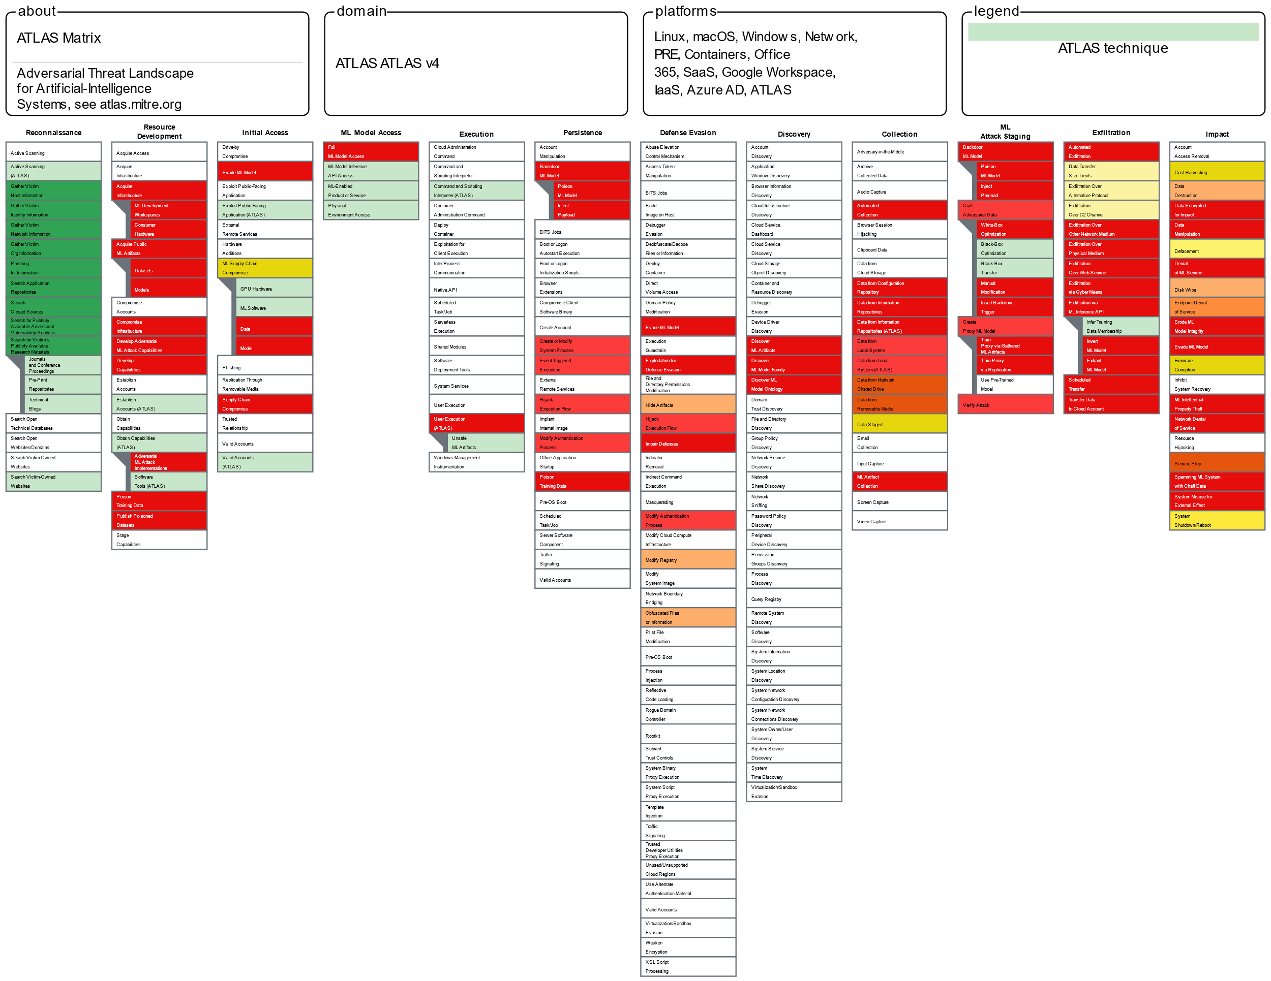
Company
Framework
MITRE
ATLAS
Nature
Attacker
White Box
Insider

Slide 14
Strategy
Case
Attack Plan
Scenario 2
Attack Types
Objective
Reverse Engineering
Present Model with Erroneous Data, Evade model Through Adversarial Examples.
Exfiltrate
Data Poisoning
Inference
Adversarial Attacks
Training & Inference
Probability
Output
Impact
Evasion Through Confusing/Poisoning Model/Poisoning Data, active persistence
Low/Mod/High
Increased

Slide 15
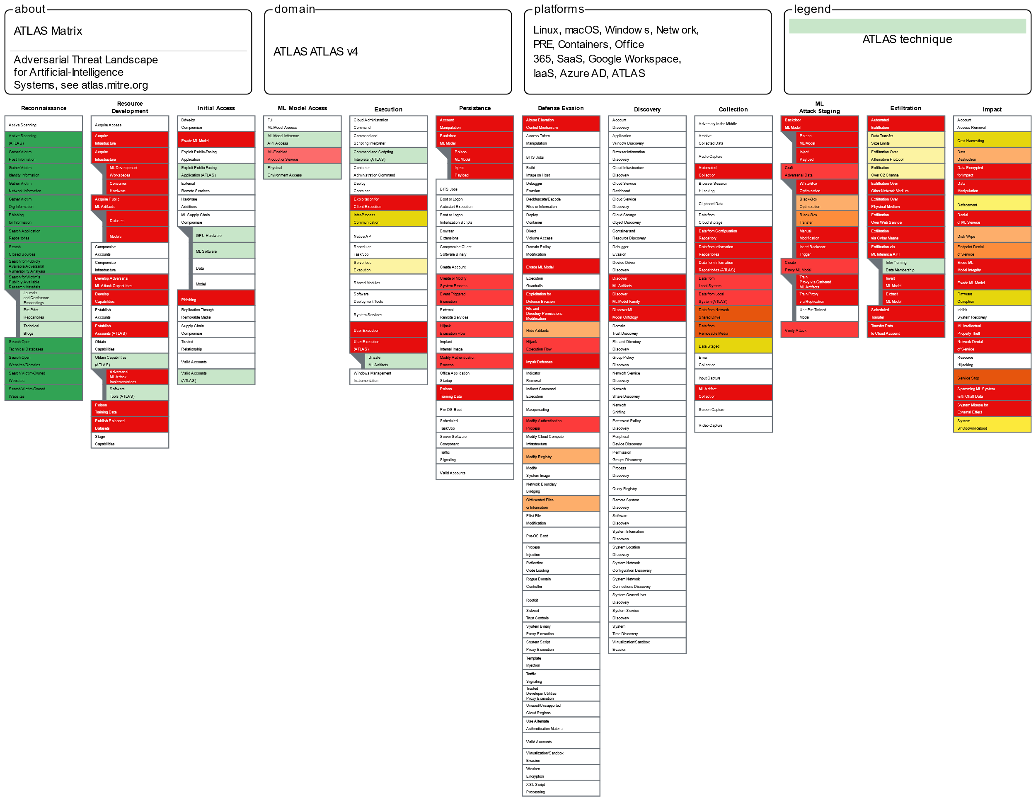
Company
Framework
MITRE
ATLAS
Nature
Attacker
Black Box
Outsider

Slide 16
Strategy
Method
DEFENSE
Red-Team / Internal
Defense Type
Adversarial Testing
Adversarial Testing
Adversarial testing holds significant importance in the field of steganalysis when applied to AI models. The primary objective of such testing is to evaluate the robustness and effectiveness of the AI model in identifying and exposing weak points.
Mitigations
Exploratory Analysis
Exploratory Analysis
Through exploratory testing, security testers actively explore the AI steganalysis model, assessing various attack surfaces, potential entry points, and concealed flaws that may expose the system to exploitation. By immersing themselves in the model, testers can proactively identify and address vulnerabilities before they can be leveraged by malicious individuals to hide sensitive information within digital content.

Slide 17

Strategy
Method
DEFENSE
AI Dev Team
Defense Type
Ensemble
Ensemble
Ensemble Method refers to a machine learning approach that enhances predictive accuracy and mitigates overfitting by combining multiple models, such as decision trees or neural network
Feature Squeezing
Inference
Mitigations
Feature Squeezing
Assessing various attack surfaces, potential entry points, and concealed flaws that may expose the system to exploitation.

Slide 18
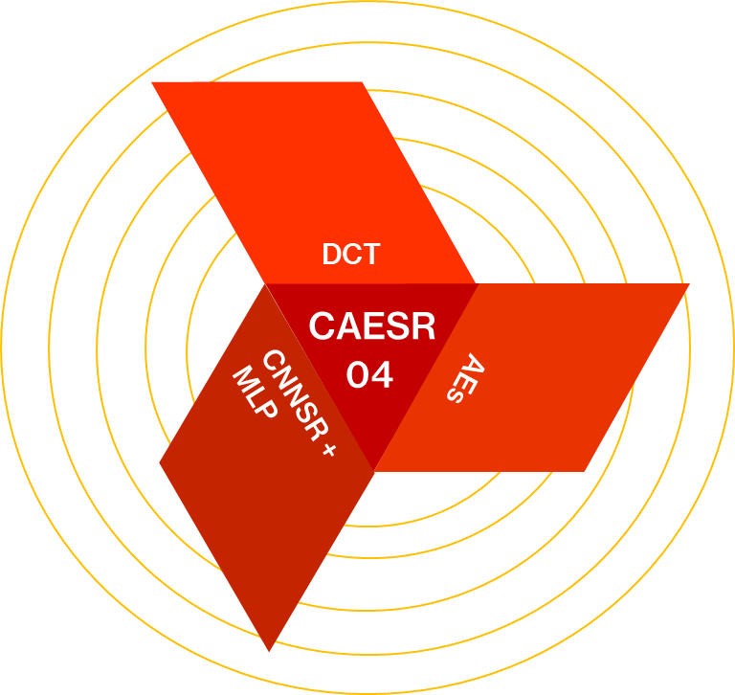
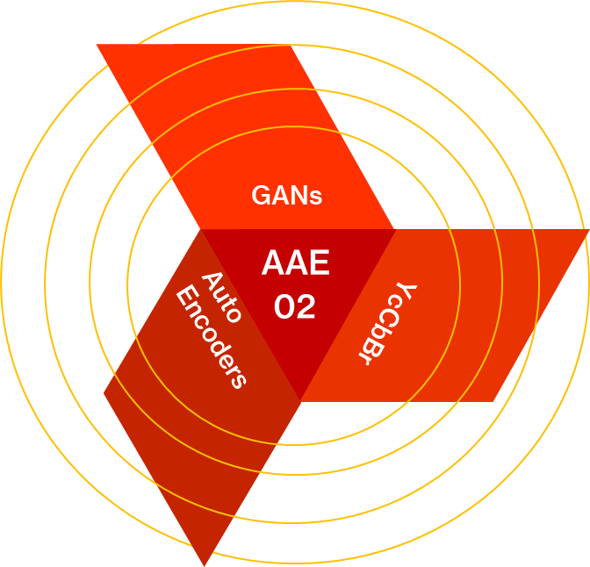
x4 Ensemble Model Architecture

Slide 19
x4 Ensemble Model Architecture
CAESR Output
NN
01
CNN
Output
AAE
Output

Slide 20
Conclusion
To conclude, this report showcases a unique approach to authenticate digital images by integrating various techniques, including CNNs and Hybrid Models. It also highlights the concept of steganography and its potential consequences. By incorporating Spatial Co-Occurrence Matrices and utilizing DCT across different colour channels, our proposed model outperforms previous methods that solely relied on CNNs, resulting in a 7% improvement in accuracy.
Furthermore, we conducted thorough assessments of our model's effectiveness and devised an attack plan to simulate potential attacks. Subsequently, we proposed and planned defensive measures to mitigate the simulated attack. These measures include employing model ensembling and conducting Exploratory Testing to evaluate our model and network against various attack surfaces, thereby reducing vulnerabilities within our system.
Overall, this research showcases the significance of integrating different techniques to enhance digital image authentication and steganalysis. By improving accuracy and strengthening our defence against adversarial attacks, we contribute to the development of more secure systems and ensure the integrity of digital media in various applications.

Slide 21
END
OF
PRESENTATION
SLIDE:15
freedom

